Slide 1
An Efficient Technique for Exploring Register File Size in ASIP Synthesis
Presenter Manoj Kumar Jain
http://www.cse.iitd.ernet.in/~manoj
Supervisors Prof. M. Balakrishnan and Prof. Anshul Kumar
Department of Computer Science & Engineering
IIT Delhi
Embedded Systems Group Seminar 30th Sept 2002

Slide 2
Outline
ASIP introduction
Overall Objectives
Register File Size exploration
Results and Validation
Conclusions and future work

Slide 3
Application Specific Instruction set Processor (ASIP)
Designed for specific application
Exploits special characteristics to meet the desired constraints
Efficient for applications like digital signal processing, automatic control systems, cellular phones

Slide 4
GPP-ASIP-ASIC
 | GPP | ASIP | ASIC
Performance | Low | High | Very High
Flexibility | Excellent | Good | Poor
HW Design Effort | Nil | Large | Very Large
SW Design Effort | Small | Large | Nil
Power | Large | Medium | Small
Reuse | Excellent | Good | Poor
Markets | Very Large | Relatively large | Small
Cost | Mainly on SW | S-O-C | Volume sensitive

Slide 5
Flow Diagram of ASIP Design Methodology
Application &
Design Constraints
Application Analysis
Architectural Design Space Exploration
Instruction Set
Generation
Code Synthesis
Hardware Synthesis
Object Code
Processor Description

Slide 6
Approaches in ASIP Design Space Exploration
Application
(C)
Retargetable
Compiler
Object
Code
Simulator
Simulator based
Architecture
Description
Trace Data
Architecture
Description
Application
(C)
Profiler
Scheduler based
Retargetable
Estimator
Performance and
other Estimates

Slide 7
Simulator based v/s Estimation based
Simulator Estimation based
Efficient retargetable compiler No assembly code
and simulator required generation
Slower Faster
More accurate Less accurate
More arch. features explored Less arch. features explored

Slide 8
Previous work on Storage Exploration
Register banks , I/D-Cache [Gloria90, Gong95, Kin99]
Attempt to optimize register count based on profiler information but method needs code generation and analysis [Honma94]
Language based approach [Mishra2001]

Slide 9
What needs to be done and overall objectives
Increasing dimensions of design space
Design space exploration needs to be very fast
Storage organization to be explored by scheduler based approach
Exploring Register File Size, Cache design space and other storage structures

Slide 10
Register Size Evaluation: Objectives
Study the impact of changing register file size on performance, power and energy
Analyze the observations of above study and finding relevance of exploring register file size in ASIP design
Develop an estimation based framework for quick evaluation of register file size
Implement and validate the analytical framework

Slide 11
Motivating Study: Study the imact of change in Register file size
Methodology
Parameterized compiler for ARM
Execution
Code-size, cycle, power and energy analysis
Parameter values
Decision for next parameter value

Slide 12
Experimental Setup
Benchmark
Suite
encc
Compiler
Instruction Set
Simulator
Register File
Size
Trace Data
C Code
encc
assembly
Assembler &
Linker
executable
energy
database
profiling
information
trace
analyzer
trace file
ISS

Slide 13
Results
Range Number of registers 3 to 8
Memory configurations
- only off chip
- on-chip instruction off-chip data
Results collected
- number of instructions executed
- number of cycles
- ratio of spilling instructions (static)
- power consumption
- energy consumption

Slide 14
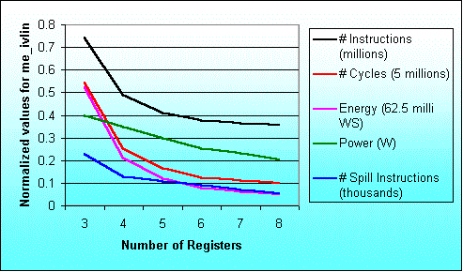
Result for the program me_ivlin
knee due to exec. time reduction
knee due to power saving

Slide 15
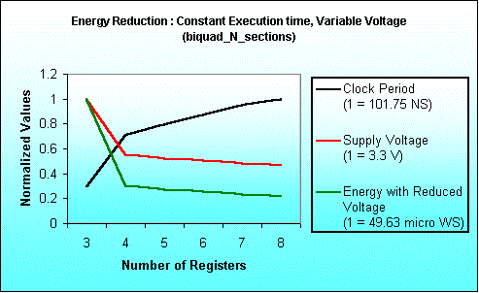
Energy Saving due to
Voltage Scaling
Notes:
Here we have assumed total execution time as constant.
To keep execution time as constant when execution requires lesser number
of cycles we have increased the clock period.
With the increased clock period we can reduce supply voltage.
For estimating supply voltage with varying clock period we had referred
The paper titled “Low Power CMOS Digital Design” – A.P Chandrakasan et al
IEEE J. Solid-State Circuits, Vol. 27, No. 4, pp. 473-484, April 1992.
With this estimated voltage we have calculated Energy.
Since Energy is product of Average Power Consumption and Execution time,
here Execution time is constant and
Power depends quadratically on Voltage.
Keeping these facts into consideration we have computed
Energy Consumption.

Slide 16
Maximum variation in results
Benchmark Program | Performance |  | Power |  | Energy
 | Reg. size | % inc. | Reg. size | % red. | Reg. size | % red.
biquad_N_sections | 3 → 4 | 57.5 | 3 → 4 | 12.6 | 3 → 4 | 62.9
lattice_init | 4 → 5 | 20.5 | 6 → 7 | 1.0 | 4 → 5 | 21.0
matrix-mult | 3 → 4 | 29.7 | 7 → 8 | 7.4 | 3 → 4 | 33.4
me_ivlin | 3 → 4 | 53.4 | 5 → 6 | 15.3 | 3 → 4 | 59.3
bubble_sort | 4 → 5 | 46.3 | 4 → 5 | 17.3 | 4 → 5 | 55.6
heap_sort | 6 → 7 | 25.6 | 6 → 7 | 10.3 | 6 → 7 | 33.2
insertion_sort | 4 → 5 | 44.8 | 4 → 5 | 22.3 | 4 → 5 | 57.1
election_sort | 3 → 4 | 22.2 | 5 → 6 | 14.0 | 5 → 6 | 30.1
Average |  | 37.5 |  | 12.5 |  | 44.1

Slide 17
Conclusion from this phase of work
Studied results for number of inst. executed cycles, spilling, power and energy consumption for ARM7TDMI processor. Similar results for LEON processor.
Range of number of registers 3 to 8.
Single increase in number of registers results in up to 57.5% performance improvement and 62.9% reduction in energy consumption.

Slide 18
New Technique for Register File Size Evaluation
Scheduler based approach
Code generator as well as simulator not required
Fast compared to simulator based techniques
Validated for ARM7TDMI, TM-1000 and Leon
Simple machine description
Easily Retargetable

Slide 19
Register file size evaluation methodology
Application
Profiling
Processor description
SUIF
Profile information
SUIF IR
Dependence analysis
Control flow graph
Data flow graph
Local register allocation
using reuse chains
Estimate overhead to
handle global needs
For each Basic Block
Modified data flow graph
Local execution time estimate
Schedule overhead
due to global needs
Scheduling
For each function
Schedule estimate of single
execution of the basic block
Execution time estimates

Slide 20
Register allocation using Register Reuse Chains
A Register Reuse Chain or RRC contain
all the variables assigned to the same register
Generating Initial Chains (adopted from Zhang’s approach)
Converting Initial Chains into dependence conservative chains (adopted from Zhang’s approach)
Computing merging costs (Our contribution)
Efficiently merging chains (Our Contribution)

Slide 21
Generating Initial Reuse Chains
Earliest Ultimate Killing (EUK) Node is the earliest node where Variable’s live range is guaranteed to end
Earliest Ultimate Killing or EUK nodes are used to construct RRCs
Basic Idea Recursively search the EUK nodes and assign the same register.

Slide 22
Illustrative Example
l_2
a
Variable EUK
a l
l_2 b
b l
l_3 c
c g
l_4 d
d g
e g
f g
g h
l_5 h
h k
l_6 i
i k
l_7 j
j k
k l
l l
load a;
b=2*a;
c=a+3;
d=a-4;
e=c*d;
f=c-d;
g=e/f;
h=g+5;
i=h*6;
j=h+7;
k=i/j;
l=b+k;
l_3
l_4
b
c
d
e
f
g
l_5
Source Code
h
l_6
l_7
Dependency Graph
dependency edge
additional dependency
l_x constant x loaded into reg
i
j
k
l

Slide 23
Initial Reuse Chains
Chain 0 1 2 3 4 5 6 7 8
a
l_2
l_3
l_4
l_5
l_6
l_7
e
f
l
b
c
d
j
g
i
h
k

Slide 24
Dependence conservative chains
Chain 0 1 2 3 4 5 6 7
a
l_2
l_3
l_4
l_5
l_6
l_7
f
b
c
d
j
l
e
g
h
i
k

Slide 25
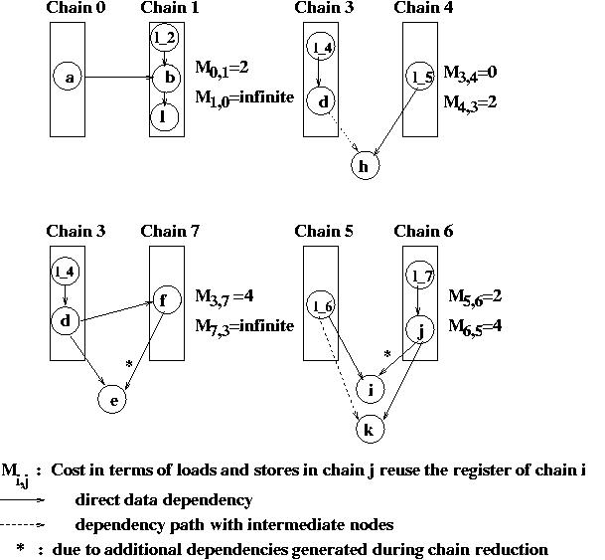
Computing Merging Costs

Slide 26
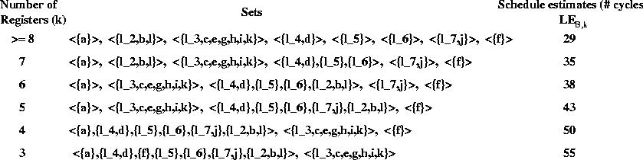
Estimates with diff. Register File Sizes

Slide 27
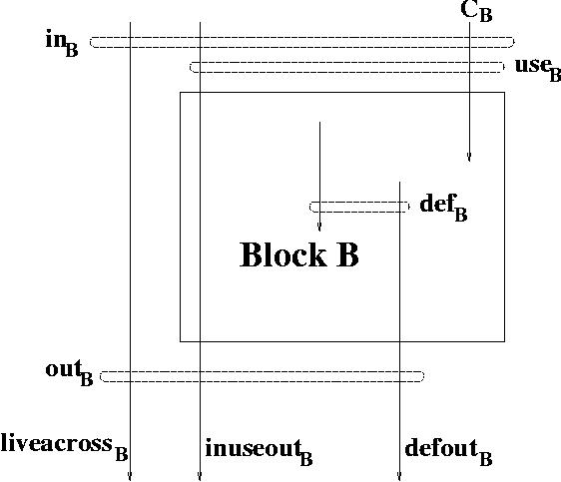
Variable use sets analysis

Slide 28
Results and Validation
Execution time estimates for selected 8 benchmark applications with varying register file sizes
Validations are done for two processors
  ARM7TDMI (ARM RISC Processor core)
  TM-1000 (Trimedia 5-issue VLIW processor)

Slide 29
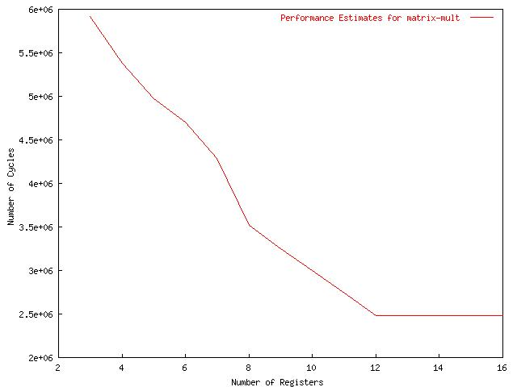
Excution time for matrix-mult with diff. Register file sizes for ARM7TDMI

Slide 30
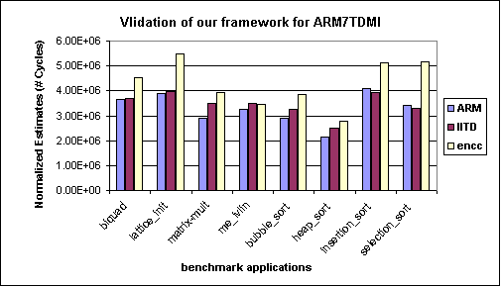
Validation of ASSIST for ARM7TDMI processor

Slide 31
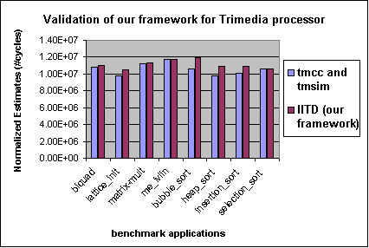
Validation of ASSIST for TM-1000 processor

Slide 32
Conclusions
Register allocation is performed before scheduling
Consider global needs
No target specific code generation or simulation
Simple processor description, retargetable
Performance is estimated using a scheduler and profile values
Validated for ARM7TDMI and TM-1000 processors

Slide 33
Future work
Explore complete storage organization considering register file size, number of register windows and multi level cache memories in a scheduler based technique

Slide 34
Thanks

